Slide 1
2019-2020 William Allen White Award Master Lists
Michelle Hammond Beverley Buller
WAW Awards program director Selection committee chairperson

Slide 2
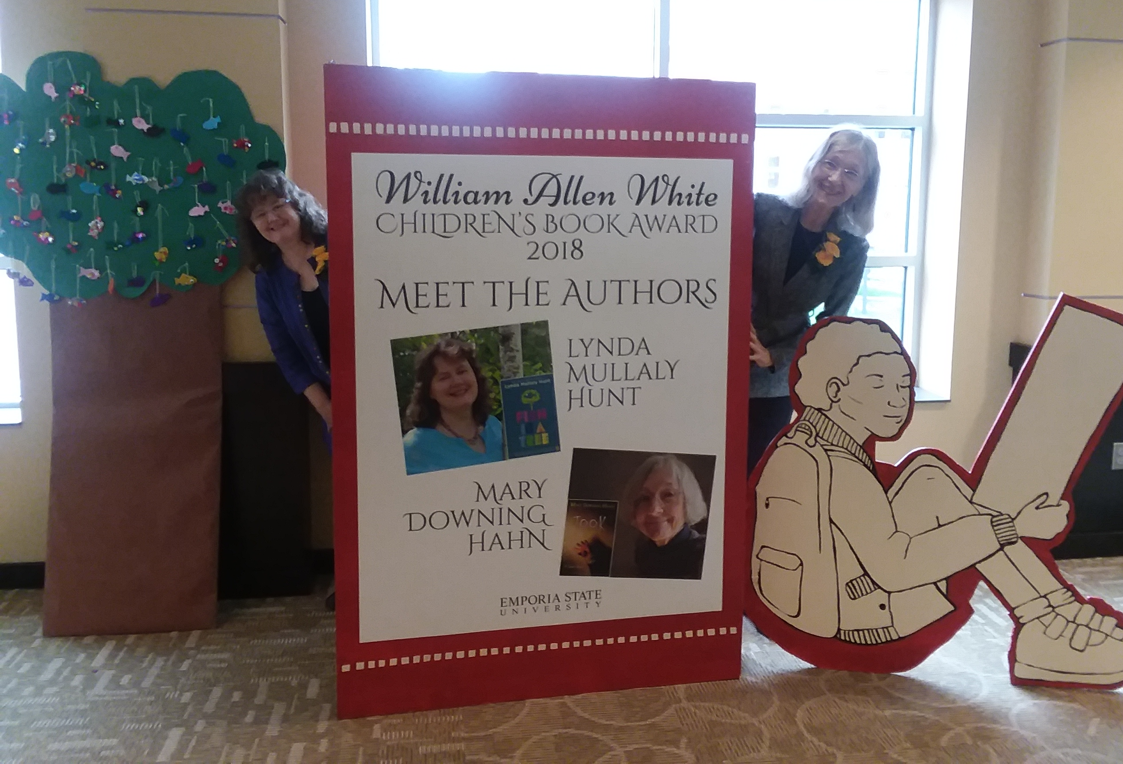
Fun with the 2018 WAW Award winners—Lynda Mullaly Hunt and Mary Downing Hahn October 6, 2018 at ESU

Slide 3
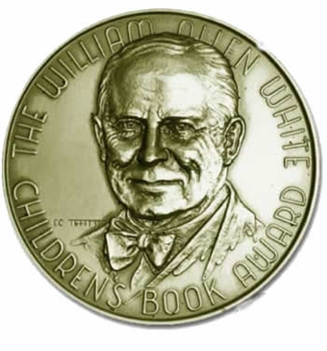
Grades 3 to 5 master lists

Slide 4
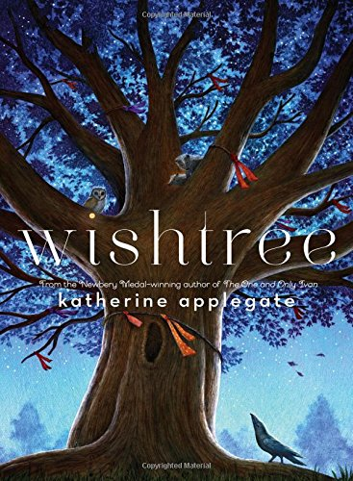
WISHTREE by Katherine Applegate Feiwel & Friends

Slide 5
LUCKY BROKEN GIRL by Ruth Behar Nancy Paulsen Books

Slide 6
INSIGNIFICANT EVENTS IN THE LIFE OF A CACTUS by Dusti Bowling Sterling Children’s Books

Slide 7
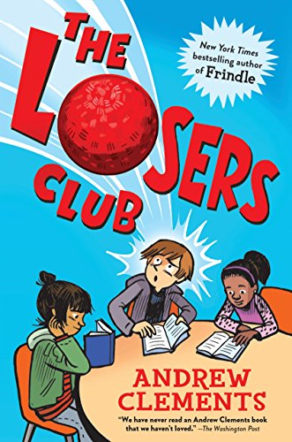
THE LOSER’S CLUB by Andrew Clements Random House

Slide 8
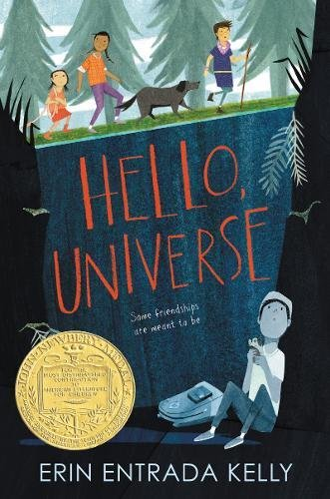
HELLO UNIVERSE by Erin Entrada Kelly Greenwillow Books

Slide 9
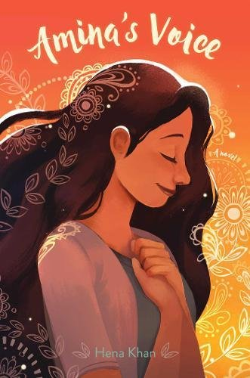
AMINA’S VOICE by Hena Khan Salaam Reads/Simon & Schuster Books for Young Readers

Slide 10
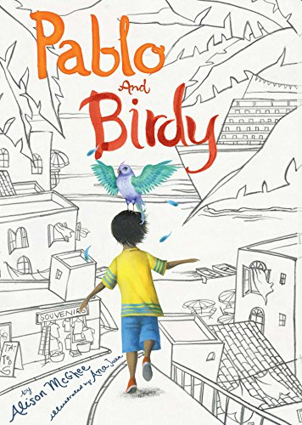
PABLO AND BIRDY by Alison McGhee Caitlyn Dlouhy Books/Atheneum

Slide 11
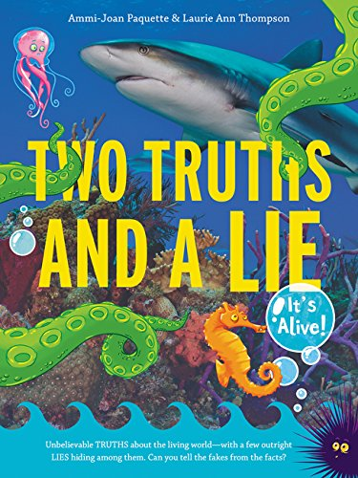
TWO TRUTHS AND A LIE: It’s Alive! by Ammi-Joan Paquette and Laurie Ann Thompson Walden Pond Press

Slide 12
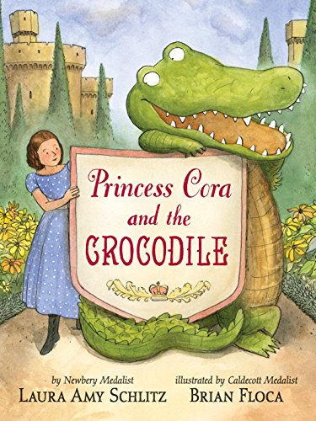
PRINCESS CORA AND THE CROCODILE by Laura Amy Schlitz Candlewick Press

Slide 13
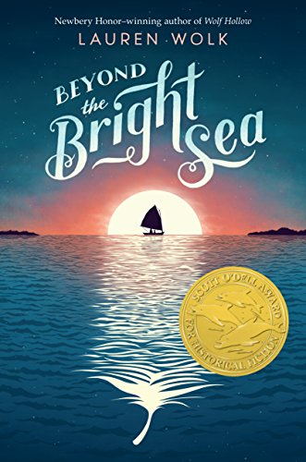
BEYOND THE BRIGHT SEA by Lauren Wolk Dutton Books for Young Readers

Slide 14
Grades 6 to 8 master list

Slide 15
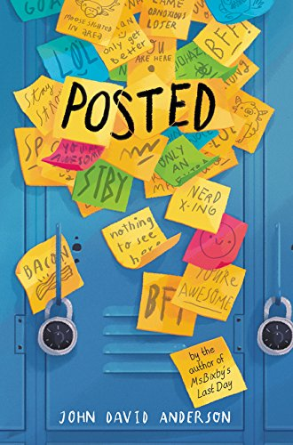
POSTED by John David Anderson Walden Pond Press

Slide 16
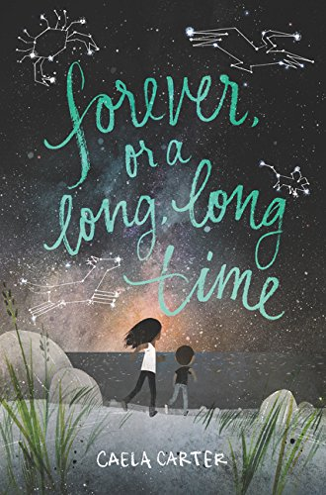
FOREVER, OR A LONG, LONG TIME by Caela Carter Harper/HarperCollins

Slide 17
SEE YOU IN THE COSMOS by Jack Cheng Dial Books for Young Readers

Slide 18
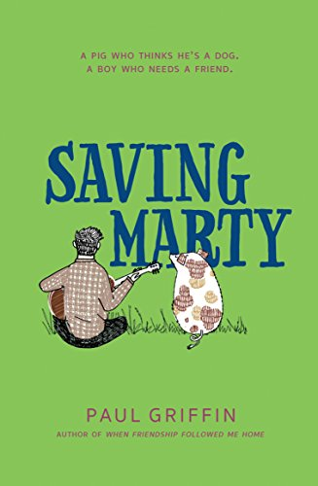
SAVING MARTY by Paul Griffin Dial Books for Young Readers

Slide 19
REFUGEE BY Alan Gratz Scholastic

Slide 20
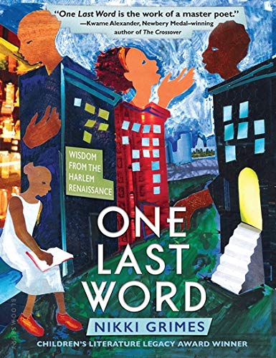
ONE LAST WORD: Wisdom from the Harlem Renaissance by Nikki Grimes Bloomsbury USA

Slide 21
SLIDER by Pete Hautman Candlewick Press

Slide 22
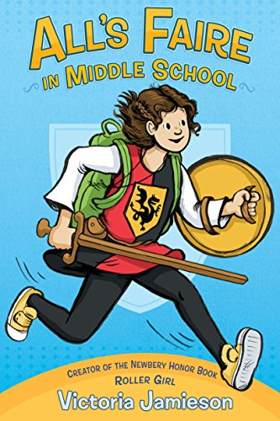
ALL’S FAIRE IN MIDDLE SCHOOL by Victoria Jamieson Dial Books for Young Readers

Slide 23
RESTART by Gordon Korman Scholastic Inc.

Slide 24
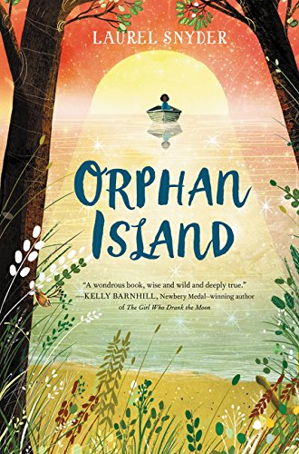
ORPHAN ISLAND by Laurel Snyder Walden Pond Press

Slide 25
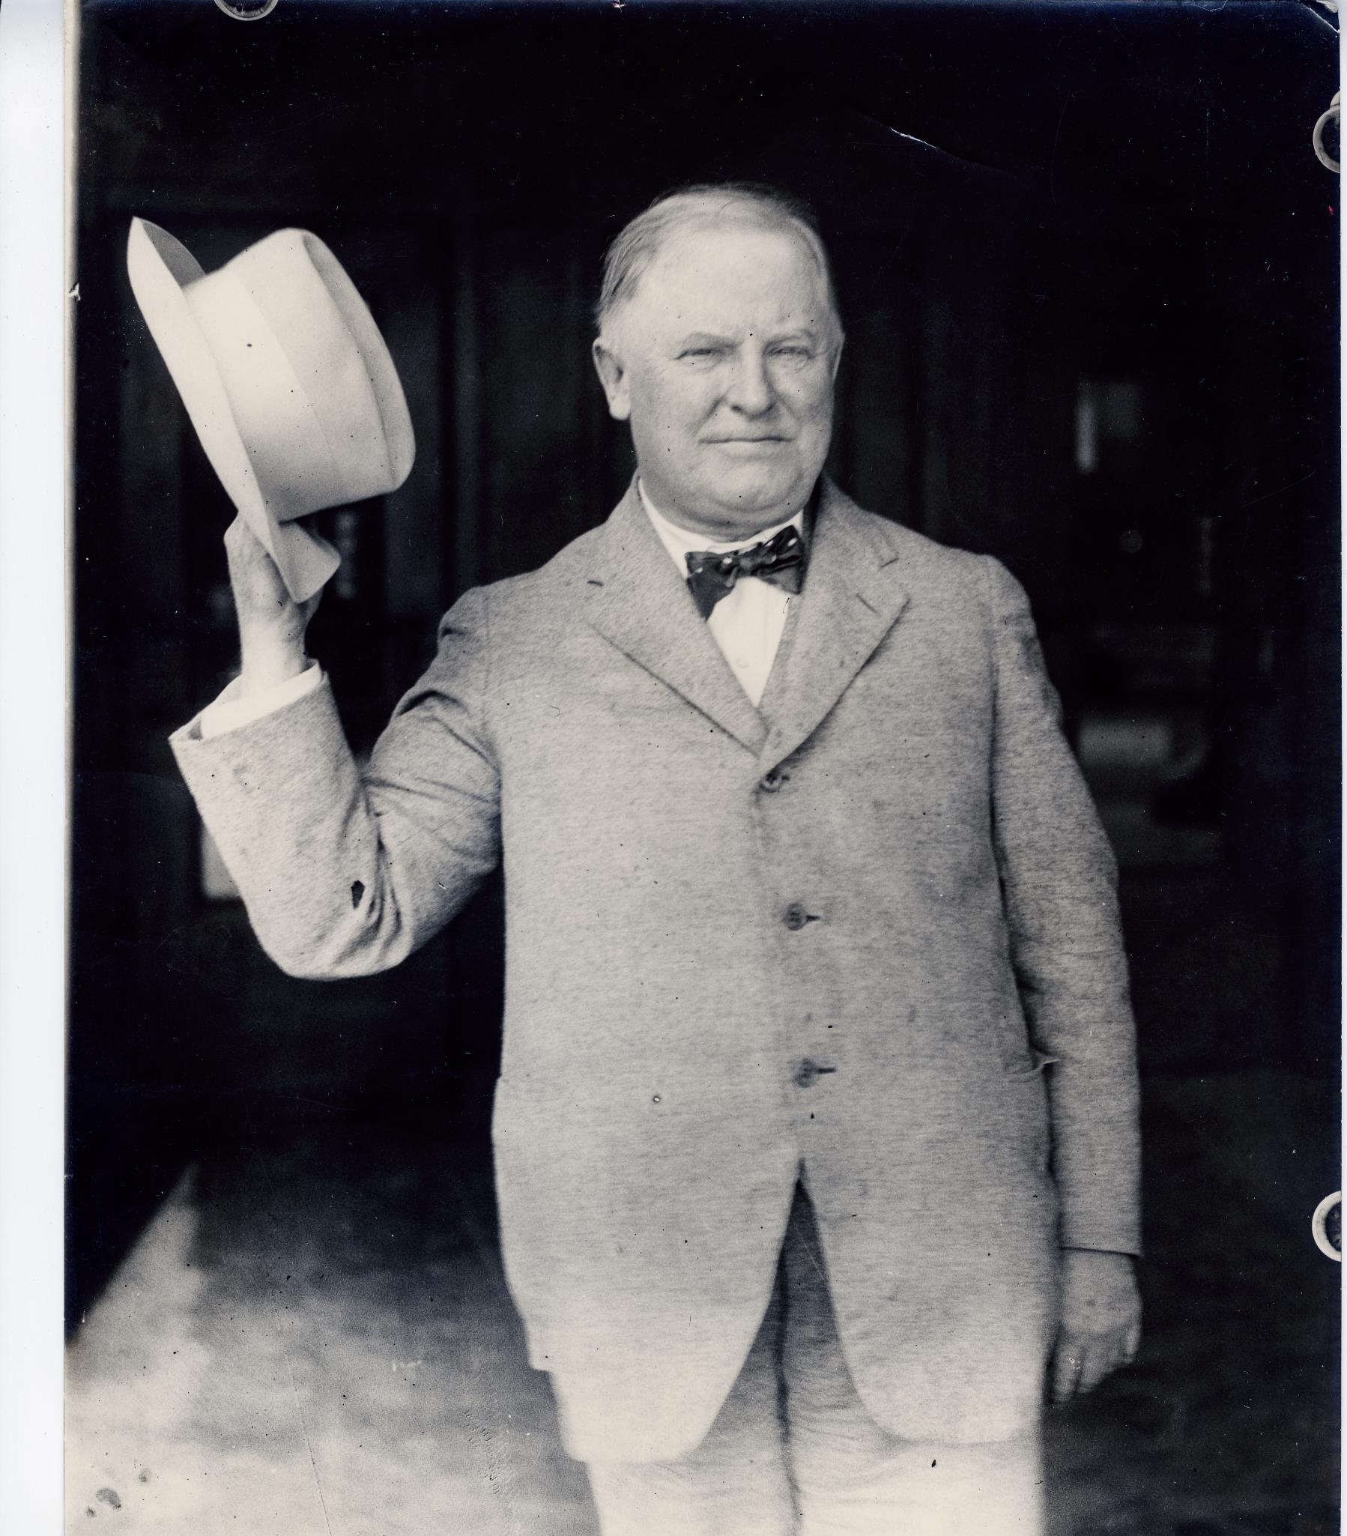
Voting for these master lists will open in January 2020! In the meantime, READ READ READ!
ESU Archives

